Slide 1
Data Analysis Binary Logistic Regression
Higher School of Economics, 2020
Author: Alisa Melikyan, PhD, senior lecturer of the School of Software Engineering

Slide 2
Binary logistic regression
Logistic regression is a multiple regression with an outcome variable that is a categorical and predictor variables that are continuous or categorical.
In binary logistic regression the dependent variable is dichotomous. So we can, for example, predict in which of two categories a person is likely to belong to given certain other information. Permits to evaluate the probability of presence/absence of some characteristic.

Slide 3

Probability of Y occurring
In logistic regression, instead of predicting the value of a variable Y from predictor variables we predict the probability of Y occurring given known values of the predictor variables.
p – probability of Y occurring,
e – base of natural logarithms,
z = b 1*X 1 + b 2*Х 2 + ...+ b n *X n + a

Slide 4
Interpretation of the probability
The resulting value from the equation is a probability value that varies between 0 and 1. It’s the probability of occurring an event that corresponds of the highest value of Y. A value close to 0 means that Y is very unlikely to have occurred, and a value close to 1 means that Y is very likely to have occurred. If the probability is less than 0,5 we will conclude that it’s unlikely that the event will occur.

Slide 5
Why can’t we apply linear regression?
We can’t apply linear regression directly to a situation is which the outcome variable is dichotomous because one of the assumptions of linear regression is that the relationship between variables is linear.
In the binary logistic regression we transform the data using the logarithmic transformation. This has the effect of making the form of the relationship linear whilst leaving the relationship itself as non-linear. In the formula above we express the multiple linear regression equation in logarithmic terms and thus overcome the problem of violating the assumption of linearity.

Slide 6
Which model is the best?
The chosen model will be the one that, when values of the predictor variable are placed in it results in values of Y closest to the observed values.
So, the values of the parameters are estimated using the maximum-likelihood estimation, which selects coefficients that make the observed values most likely to have occurred.

Slide 7
Assessing the model
In logistic regression we use the observed and predicted values to asses the fit of the model. The measure is called log-likelihood.
The log-likelihood is based on summing the probabilities associated with the predicted and actual outcomes. It’s analogous to the residual sum of squares in multiple regression in the sense that it’s an indicator of how much unexplained information there is after the model has been fitted.
So the larger the value of the log-likelihood, the more unexplained observations there are.
The baseline model is the model with no predictors and has only the constant.
There are several pseudo-R-squared to assess the goodness of fit.

Slide 8
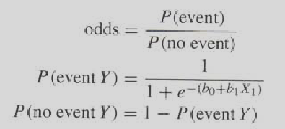
Ехр (В)
The value of exp b is the indicator of the change in odds resulting from a unit change in the predictor.

Slide 9
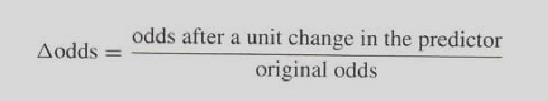
Ехр (В): example
Dependent variable: the student has passed the exam or not.
Predictor variable: the student prepared for the exam or not.
The odds of passing the exam are the probability of passing the exam divided by the probability of not passing it.
To calculate the change in odds that results from a unit change in the predictor we first calculate the odds of passing the exam given that there was no preparation for it. Then we calculate the odds of passing the exam given that there was a preparation.
Finally we calculate the proportionate change in these two odds.

Slide 10
Ехр (В): interpretation
If the value is grater than 1 then it indicates that as the predictor increases, the odds of the outcome occurring increase.
A value less than 1 indicates that as the predictor increases, the odds of the outcome occurring decrease.

Slide 11

Incomplete information (1)

Slide 12
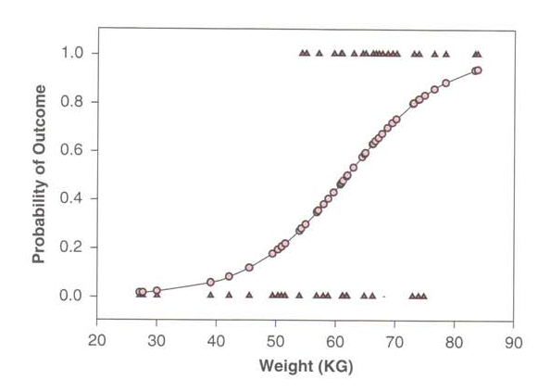
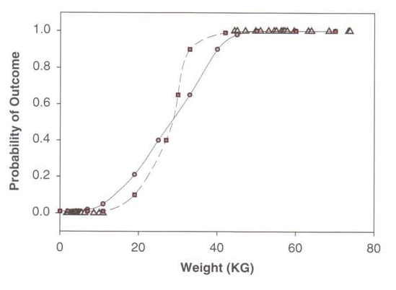
Incomplete information (2)

Slide 13
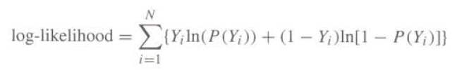

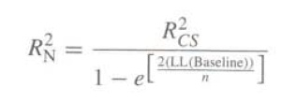
Statistical Characteristics

Slide 14
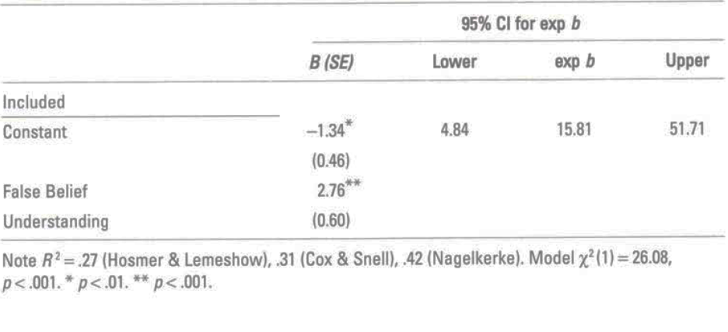
Reporting the Results

Slide 15
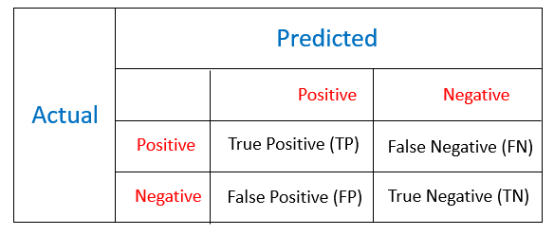
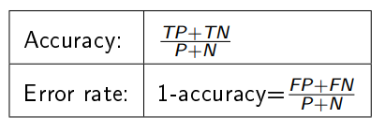
Confusion Matrix
P and N - number of observations of positive and negative class.
P = TP + FN, N = TN + FP

Slide 16
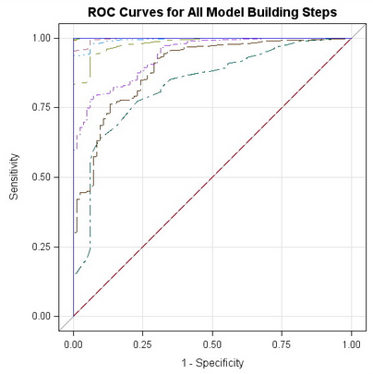
ROC-curve
Receiver Operator Characteristic Curve – a graph that permits to evaluate the quality of the binary classification.

Slide 17
Stata Commands
Model:
logit/logistic depvar predictor1 predictor2 i.predictor3…
Confusion matrix: estat classification
ROC Curve: lroc
Saving probabilities for each case: predict pr
Residuals:
Save as a variable: predict r, rstandard
Descriptive statistics: summarize r, detail
Testing the normality: kdensity r, normal

Slide 18
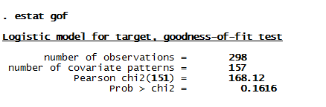
Stata Output: goodness-of-fit test
Interpretation: the probability value is greater then 0,05, so there is no significant difference between real values of the dependent variable and the values predicted by the model.

Slide 19
Useful Links
http://www.dataschool.io/roc-curves-and-auc-explained/
http://www.navan.name/roc/

